Slide 1
Web Development year 10 digital technology HTML, CSS, VSCode, design, accessibility
Oliver White
This document will be submitted to the OLE with your evidence and reflections

Slide 2
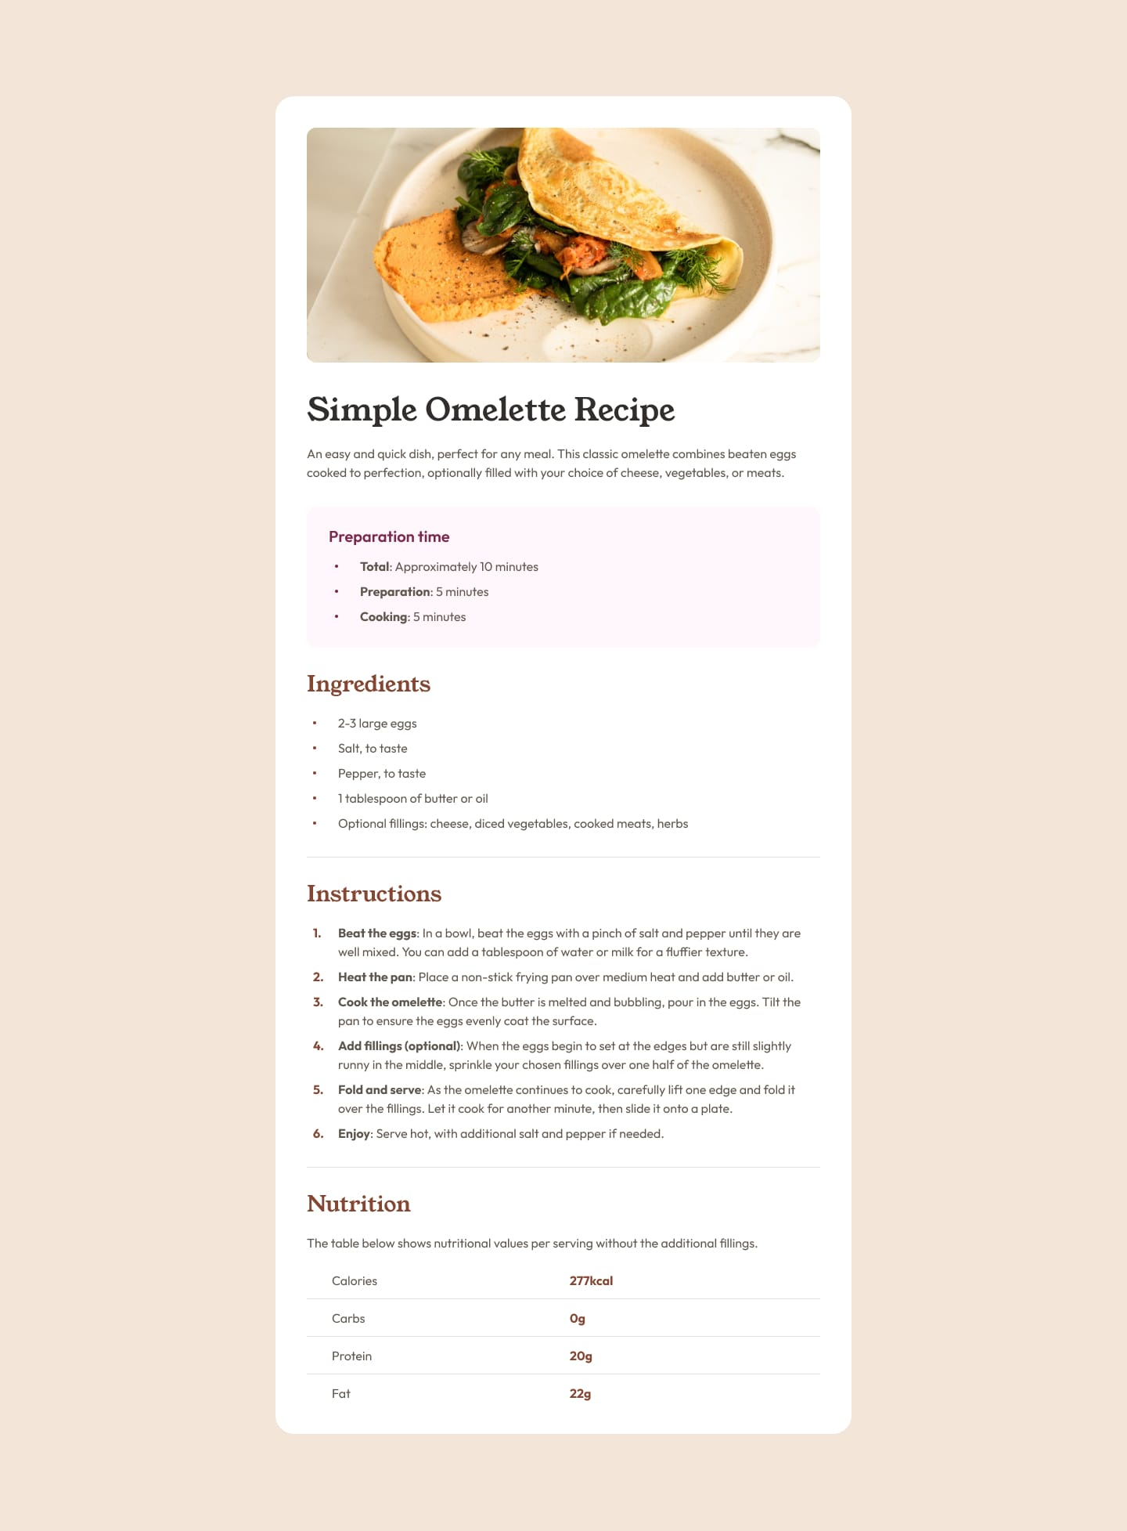
Brief
Part 1: recipe.html
Your challenge is to build out this recipe page and get it looking as close to the design as possible.
You can use any tools you like to help you complete the task (VSCode, repl.it, Adobe Color, coolors.co, etc).
Colors, fonts are given to you in the Style Guide slide of this document.
Part 2: recipe_design.html
Redesign the page in your style, modify layout and colors, and improve accessibility of the page.
Use any resources to ensure good usability feedback (you will need a minimum of 2 testers).
Part 3:
Fill in this Evidence Document and submit to the OLE before the final deadline.

Slide 3
Final Outcome → duplicate this slide if you need to
Insert link(s) to your repl.it https://replit.com/~ (your teacher can help you with uploading your folder, before the deadline – not on the day it’s due!)
Insert snapshots of all of the pages you have made

Slide 4
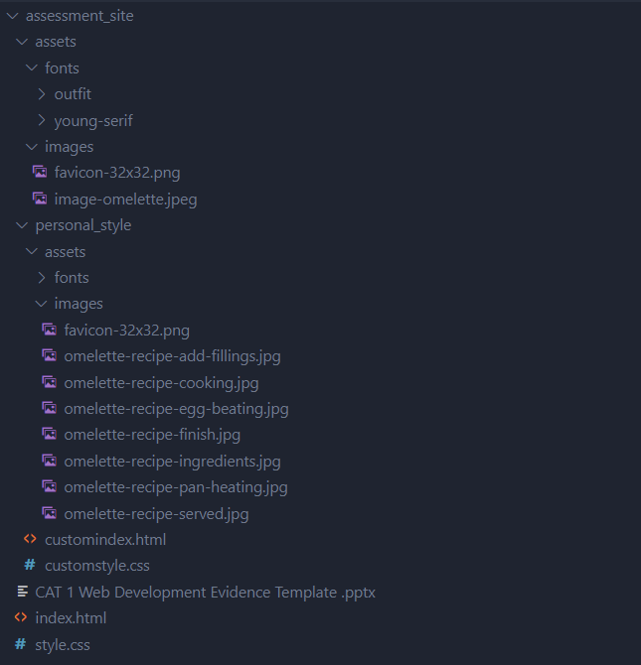
Folder Management
Insert below a snapshot (s) of your folder set up
Make sure your file names are descriptive (boat.png not untitled1.png)
Check all of your images are in the ‘images’ folder

Slide 5
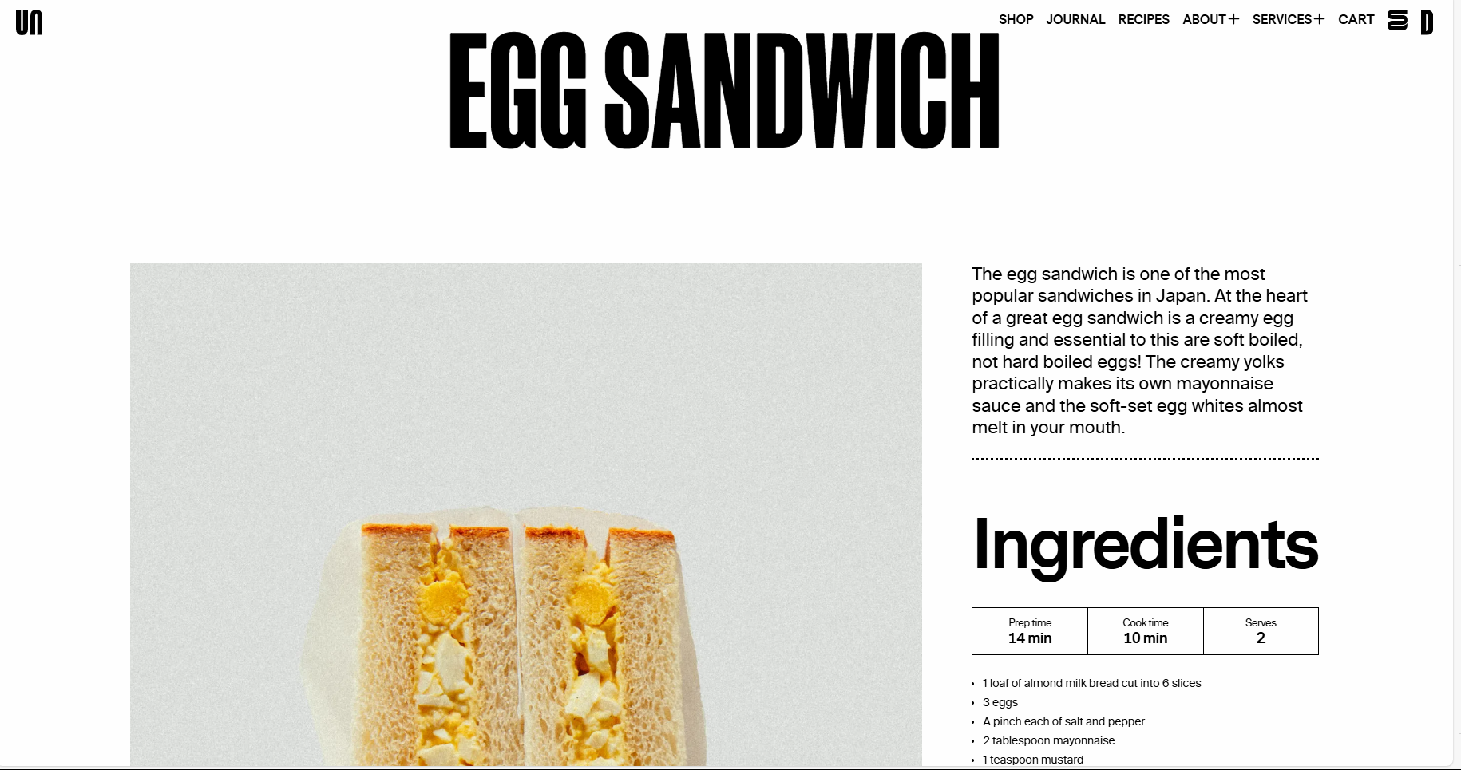
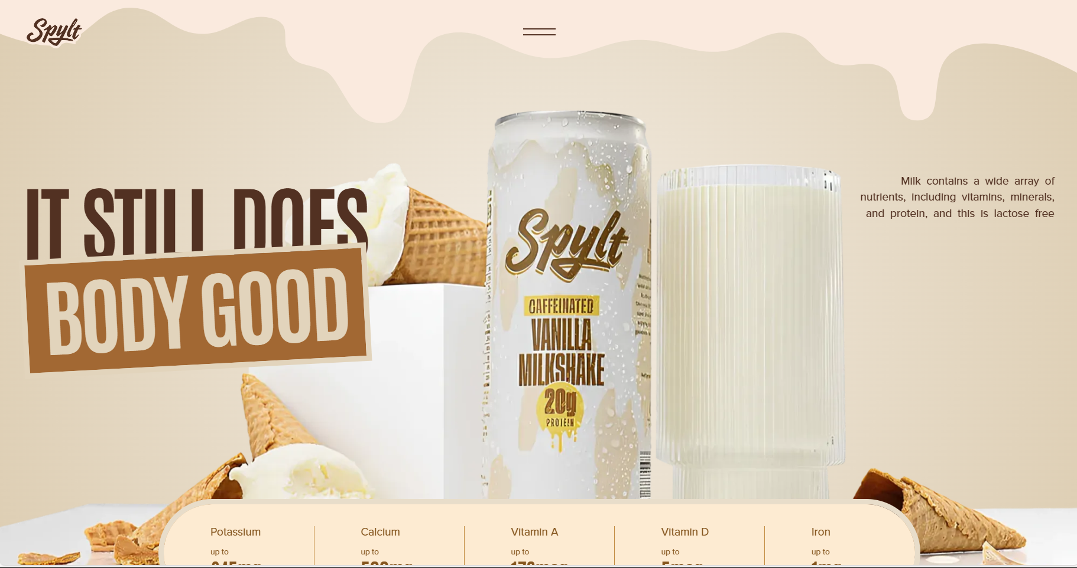
Ideation / Research Evidence / Visual Board of ideas
DESIGN # 1 use https://www.awwwards.com/ for inspiration
Insert snapshots of ideas you would like to implement (layout/fonts/colours)
Fonts- simple, but headings stand out
Heading: Helvetica Condensed Black SE
Body: Inter
Colours – Light, neutral tones, leaning towards warm

Slide 6
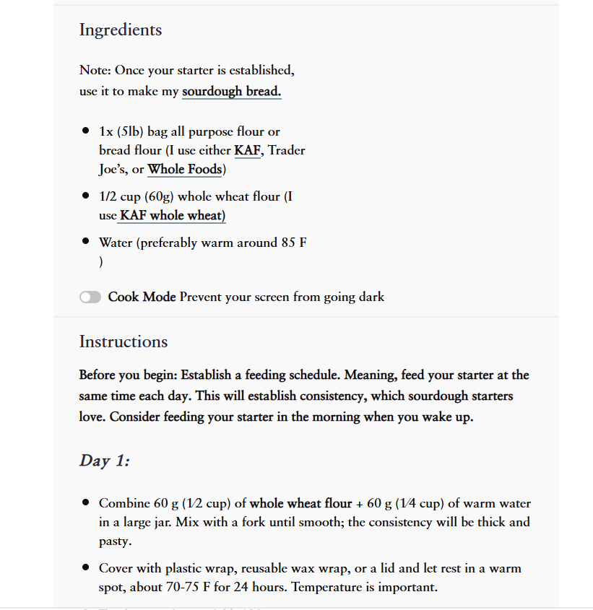
Ideation/ Research Evidence /Visual Board of ideas
Layout – recipe card style
Bold and underline for links and key info
DESIGN #2
Same as for previous design
Insert snapshots of layouts/fonts/colours you would like to use`
Omelette Recipe – JoyFoodSunshine
-Image source for instructions

Slide 7
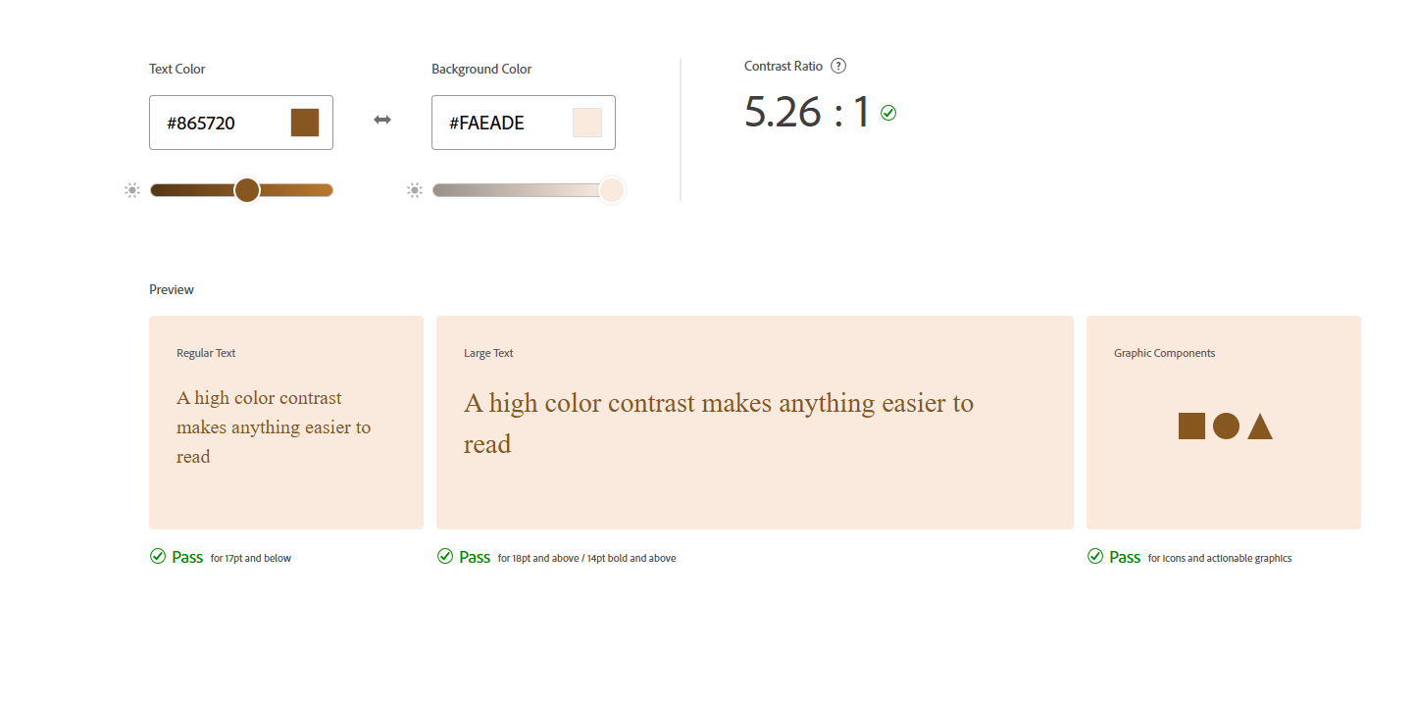
Accessibility - example of colours, theme and tools https://color.adobe.com/create/color-accessibility
Use the link above to check and improve the accessibility of your designs.
- use https://color.adobe.com/create/color-contrast-analyzer to check the contrast of your background versus your text colors (take snapshot)
ensure the contrast score has a green tick, and use recommendations
update your colors in your website
Colors taken directly from stylesheet

Slide 8
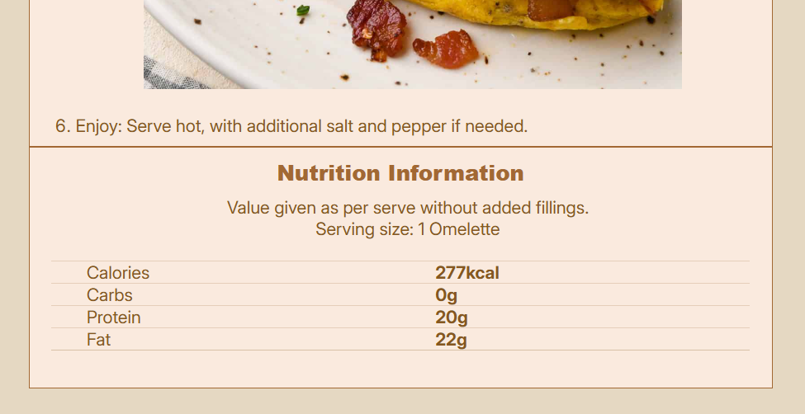
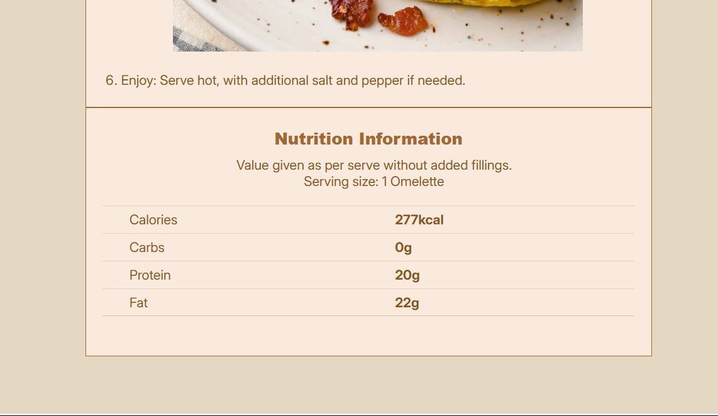
Usability Feedback – user 1 – Asher Tenenbaum
Clear layout and good contrast. The scale function is cool, but the bottom seems a little cramped together(see top picture). Maybe add some more padding/margins there.
Did exactly that, I added more spacing between items there(see bottom picture).

Slide 9
Usability Feedback – user 2 – Noah Johnson
imo it looks a bit blocky
the border on the buttons doesn't quite match the aesthetic
I like the colour scheme, feels quite homey
Images are displaying correctly, but it could look a bit nicer, idk
I would add rounding to various things
maybe add some spacing between the different sections
and round the main sections a fair bit
Added more spacing between sections(2% padding top and bottom)
Rounded a bunch of stuff
Slightly larger images
Made buttons match everything else

